Slide 1
Chapter 2 Assemblers
1
PDF created with FinePrint pdfFactory Pro trial version www.pdffactory.com

Slide 2
Outline
Pass 1
Pass 2
2
PDF created with FinePrint pdfFactory Pro trial version www.pdffactory.com

Slide 3
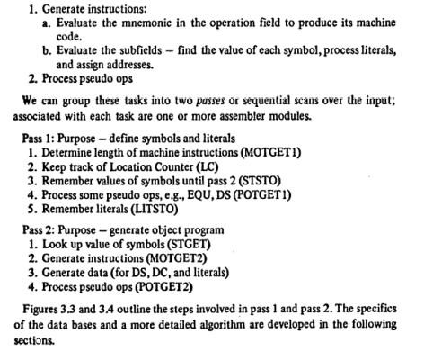
An Assembler must do the following
11

Slide 4
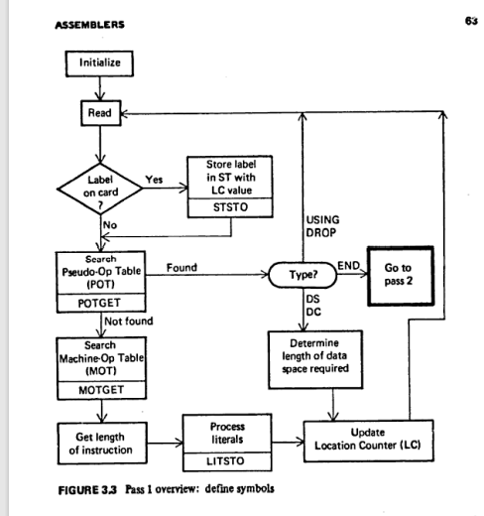
Pass 1 Overview:
11

Slide 5
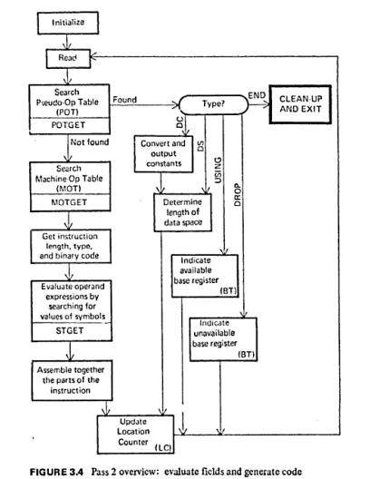
Pass 2 Overview:
11

